Slide 1


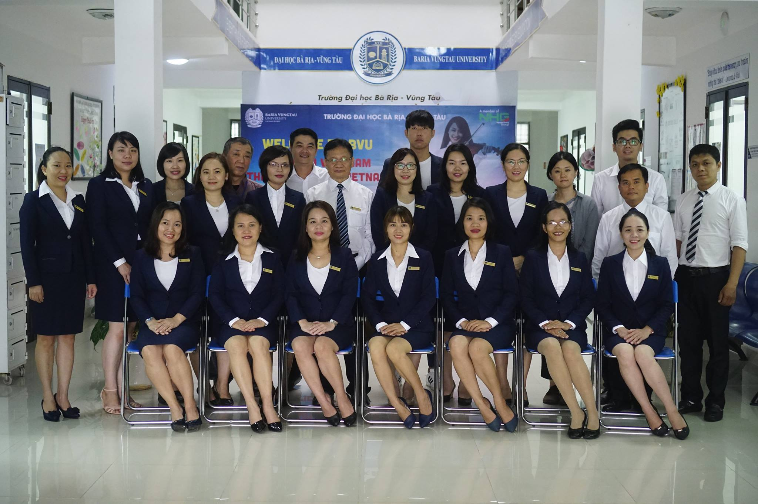

Slide 2
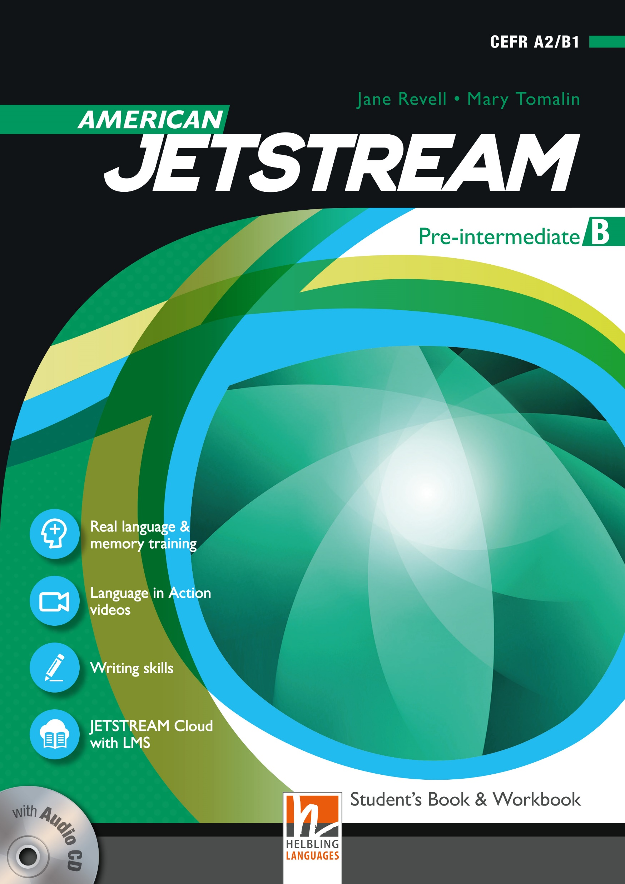
AMERICAN JETSTREAM PRE-INTERMEDIATE B

Slide 3
TEACHER’S PERSONAL INFORMATION
Name: Nguyen Thanh Loan
Facebook: Loan Nguyễn Thanh
Mobile number: 0942 255 937
Email: loannguyenthanh1978@gmail.com

Slide 4


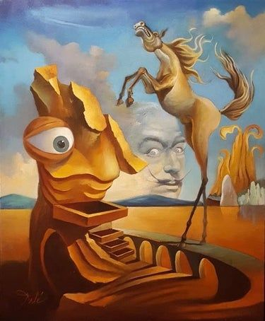
UNIT 11
Artists and writers

Slide 5

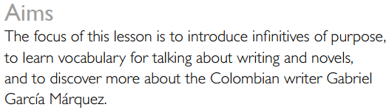
UNIT 11
Artists and writers
Lesson 3
A writer of purpose

Slide 6


Slide 7
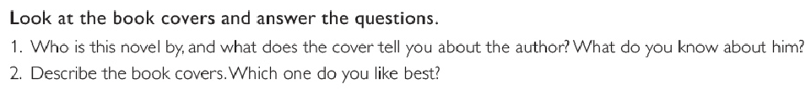

Slide 8
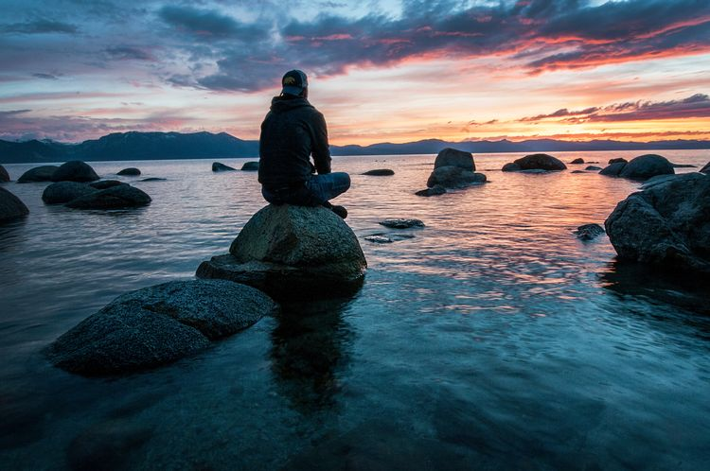
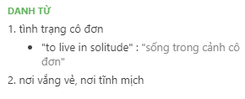
VOCABULARY
the state of being alone, especially when you find this pleasant
solitude
/ˈsɒlətjuːd/
Ex: I returned to the solitude of my room.

Slide 9
VOCABULARY
Writing and novels
Book cover book prize book review book title
Newspaper article newspaper review
Publish a novel publish an article
A short story

Slide 10
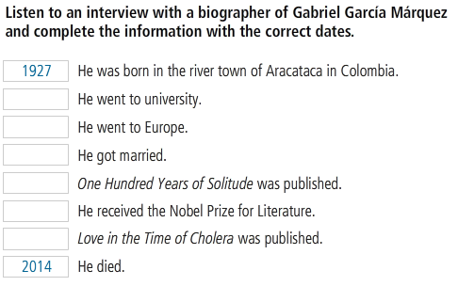

LISTENING 1

Slide 11
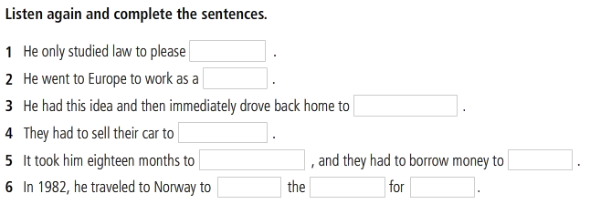
LISTENING 1

Slide 12
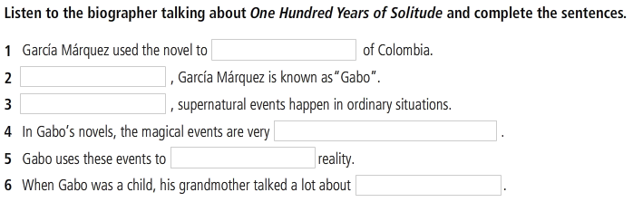
LISTENING 2

Slide 13
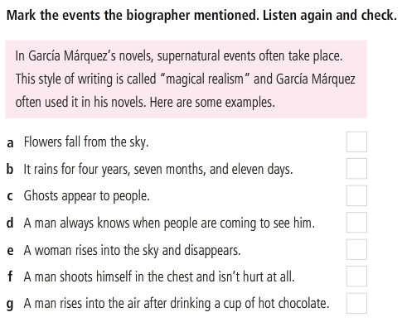
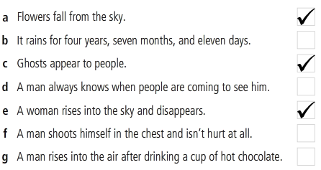
LISTENING 2

Slide 14
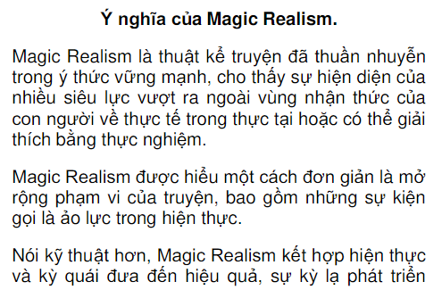
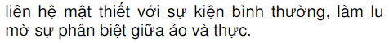
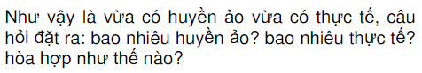
Writing style: Magical realism

Slide 15
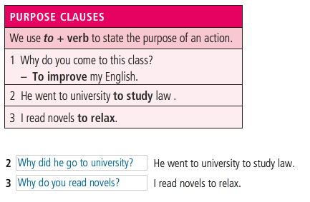
GRAMMAR
Purpose clauses

Slide 16
GRAMMAR
Purpose clauses
​1. He opened the window. He wanted to let fresh air in.
​1. He opened the window to let fresh air in.
​2. I took my camera. I wanted to take some photos.
​2. I took my camera to take some photos.
​3. He studied really hard. He wanted to get better marks.
​3. He studied really hard to get better marks.
4. Jason learns Chinese. His aim is to work in China
​4. Jason learns Chinese to work in China.

Slide 17
GRAMMAR
Purpose clauses
​5. I’ve collected money. I will buy a new car.
​5. ______________
​6. Many people left Turkey in 1960s.They wanted to find jobs in Germany.
​6. ________.
​7. She attends to a course. She wants to learn chess.
​7. ________.
8. Linda turned on the lights. She wanted to see better.
​8. ________.
https://www.englishexercises.org/makeagame/viewgame.asp?id=6268

Slide 18
GRAMMAR
Purpose clauses
Talking about your purposes.
No | Activities | Purpose
1 | Get up early | I get up early to feel that I have more time in the day
2 | Do morning exercises | I do morning exercises to improve my healthy
3 | Study foreign languages | I study foreign languages to expand my learning resources
4 | Attend a cooking class | I take a cooking class to cook better.
5 | Do yoga | I do yoga to learn how to control my body.
6 | Play sports | I play sports to train my body
7 | Do part time job | I work part-time to earn money and improve my living conditions
8 | Go to bed early | I do to bed early to wake up early
9 | Work hard | I work hard to prove myself with my family
10 | Eat lots of vegetables | I eat a lot of vegetables to strengthen my digestive system
11 | Save money | I save money to create wealth
12 | Walk to school | I walk to school to save money
13 | Became a moderator in the community | I became a moderator to lead the community I love in the right direction

Slide 19
GRAMMAR
Purpose clauses
Talking about your purposes as the sample.
A: Do you do morning exercise everyday?
B: Yes, I do
A: Why do you it?
B: I do morning exercise everyday to improve my health.

Slide 20
REFERENCES
Grammar: purpose clause
https://www.youtube.com/watch?v=P-p_o9fZZ0k
Listening: Why should you read “One hundred years of solitude”?
https://www.youtube.com/watch?v=B2zhLYz4pYo

